Slide 1




By-CHANDANA MN
20030141CSE060
BANDI RUPA SRAVYA
PROV/BTECH-CSE/LE-21/002 ASSIGNED BY-dr.t sridhar
robotics

Slide 2
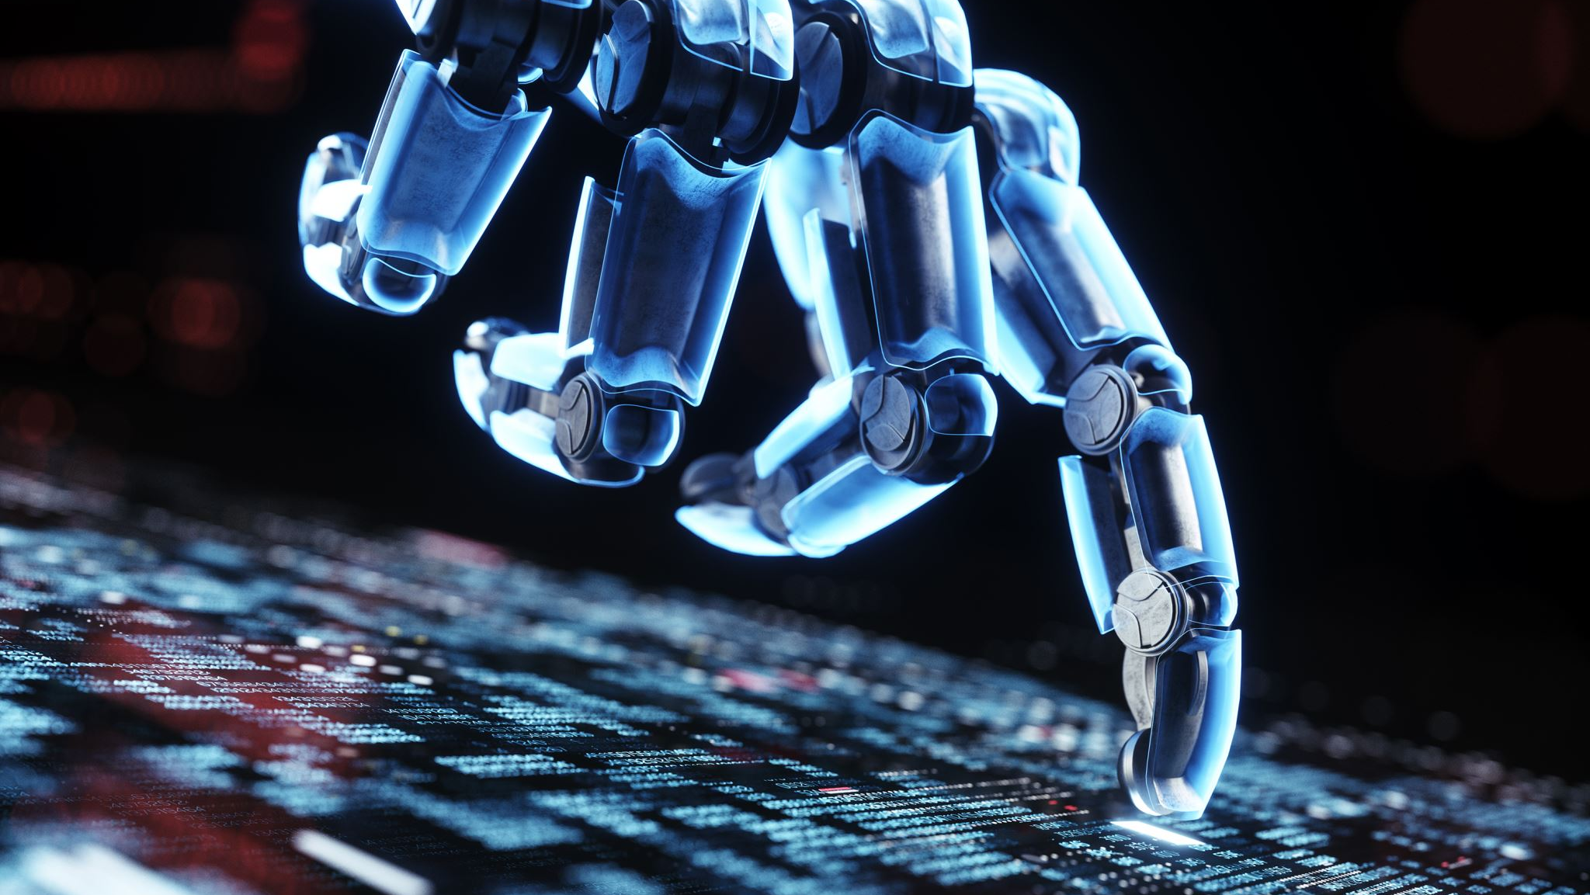
Artificial Intelligence in Robotics
z

Slide 3
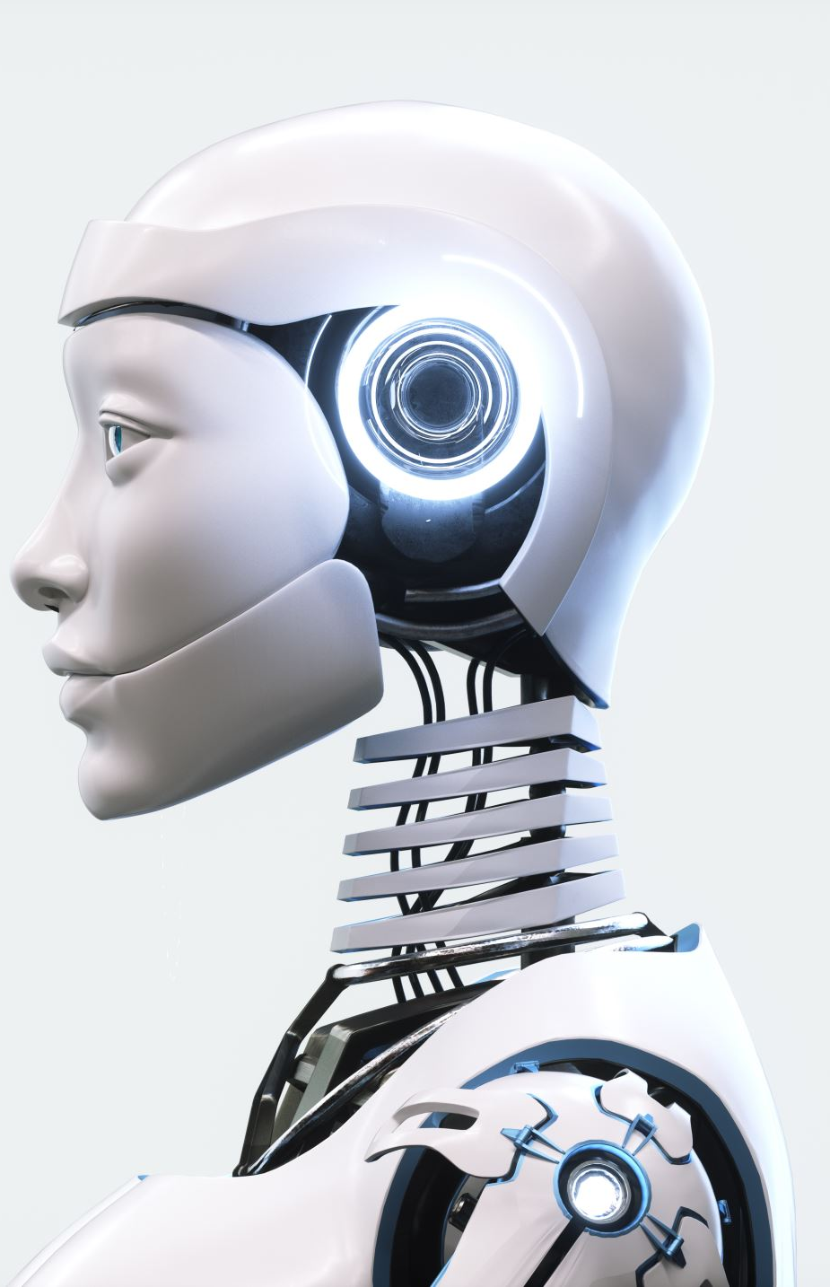
What is robotics?
Robotics is a branch of engineering that involves the conception, design, manufacture and operation of robots.
The objective of the robotics field is to create intelligent machines that can assist humans in a variety of ways.
Robotics can take on a number of forms. A robot may resemble a human, or it may be in the form of a robotic application, such as robotic process automation , which simulates how humans engage with software to perform repetitive, rules-based tasks.

Slide 4
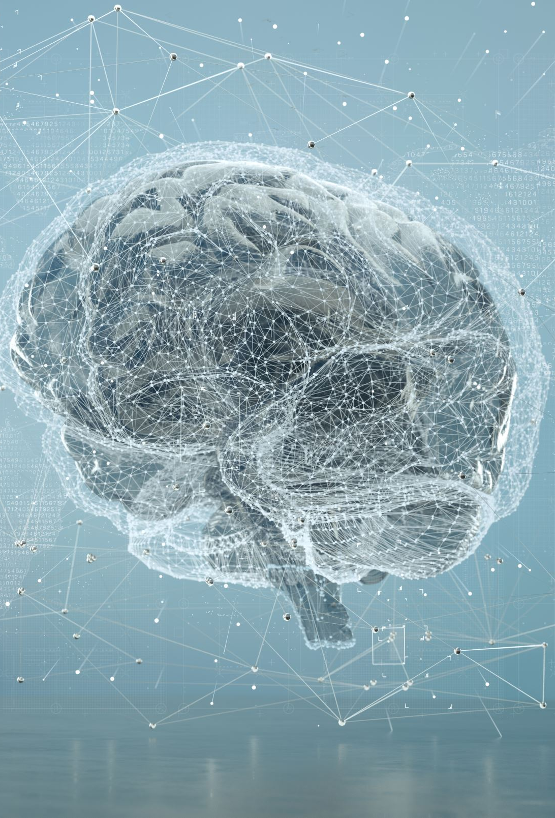
What is Artificial Intelligence
Input
Data
Sensors
Images
Artificial Intelligence
Output
Action Movement Text

Slide 5
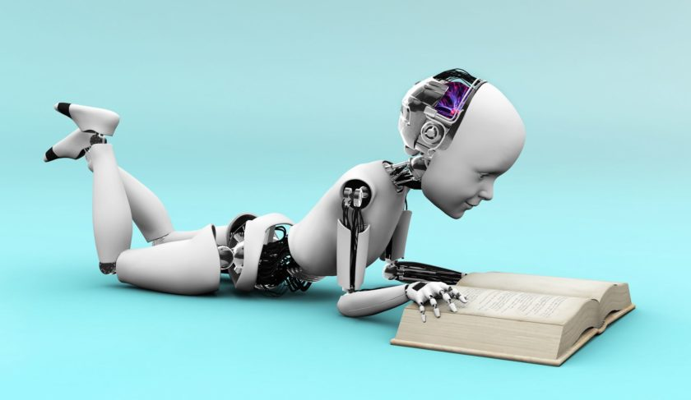
Components of Artificial Intelligence
Intelligent computer systems should be able to perform operations such as calculation, reasoning, perception of relationships and analogies, learn from experience, information storage and retrieval, problem-solving, natural language processing, classification, generalization, and adaptation.
Artificial Intelligence is composed of the following:
Problem-Solving
Logical Reasoning
Natural Language processing
Learning
Expert System
Machine Learning

Slide 6
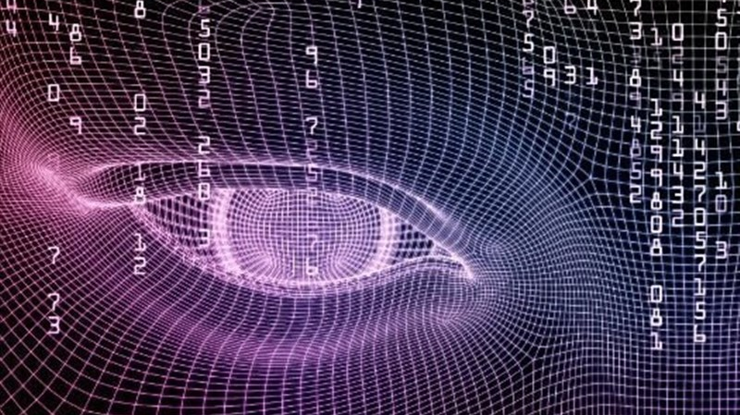
Types of Artificial Intelligence
1.Artificial Narrow Intelligence:
Machine intelligence that equals or exceeds human intelligence and efficiency at a specific task.
2.Artificial General Intelligence:
A Machine with the ability to apply intelligence to any problem, rather than just one specific problem
3.Artificial Super Intelligence:
An Intellect that is much smarter than the best human brains in practically every field, including scientific creativity, general wisdom and social skills

Slide 7
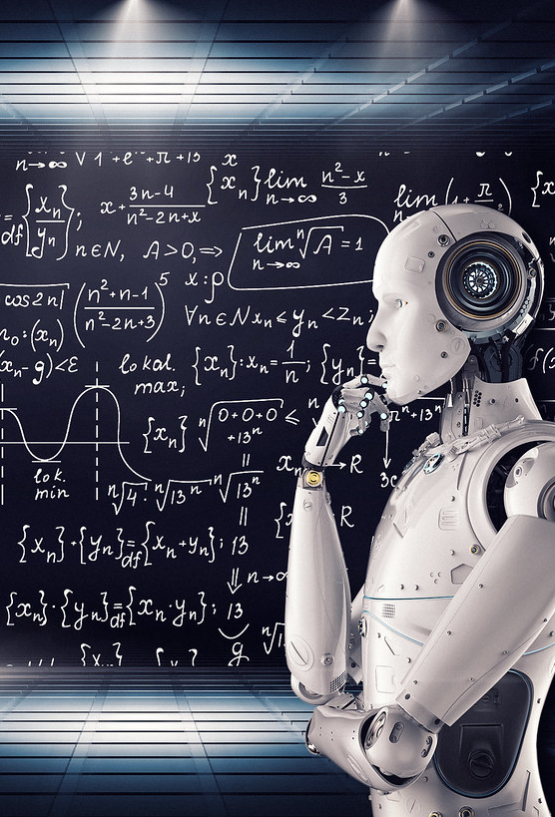
Introduction to Machine Learning
Machine Learning is a type of Artificial intelligence that provides computers with the ability to learn without being explicitly programmed
In ML we divide data into
Training
Testing
Prediction

Slide 8
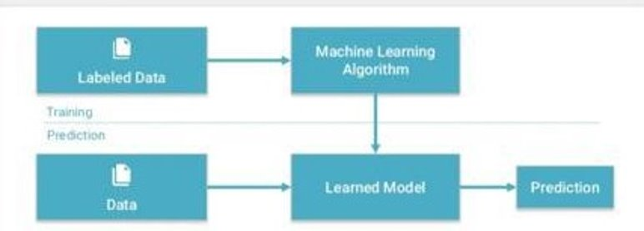

Slide 9
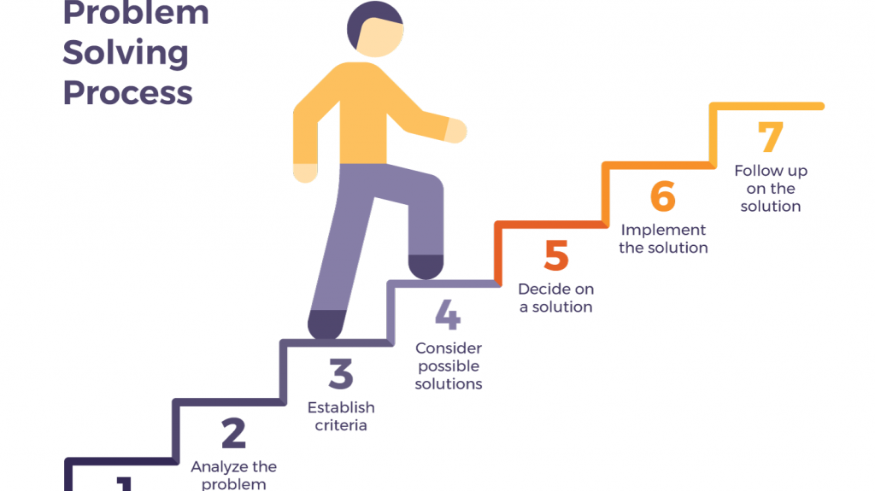
Learning Approaches in ML
Supervised Learning:
Learning with a Labeled training set
Example: Email spam detector with training set of already labeled emails
Unsupervised Learning:
Discovering patterns in unlabeled data
Example: Cluster similar documents based on the text content
Reinforcement Learning:
Learning based on feedback or reward
Example: Learn to play chess by winning or losing

Slide 10
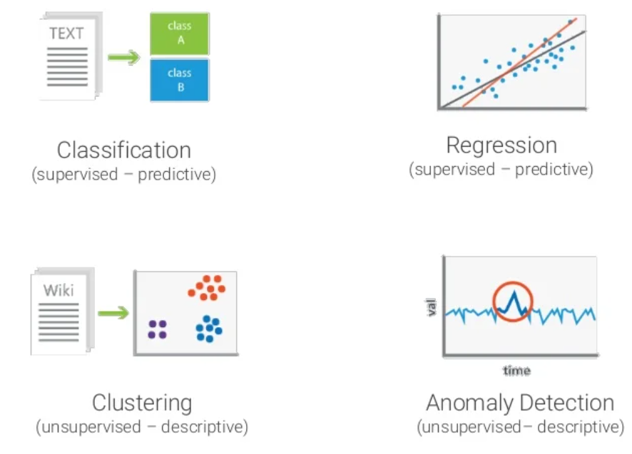

Slide 11
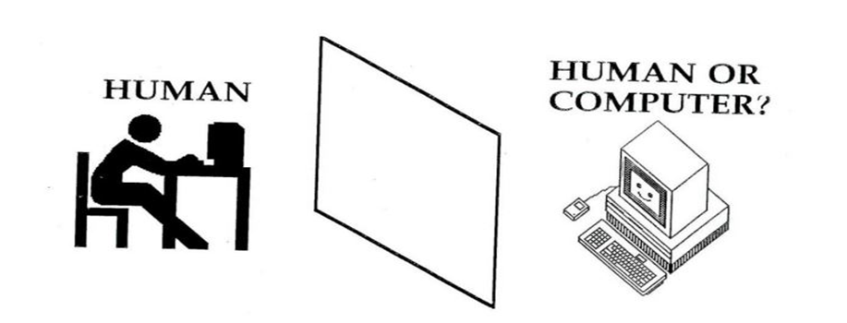
Turing Test(Alan Tuning)
The Alan Turing who was an English mathematician and pioneered Machine learning in 1950. Alan Turing publishes "Computing Machinery and Intelligence" in which he proposed a test. The test can check the machine's ability to exhibit intelligent behavior equivalent to human intelligence, called a Turing test
If the human cannot tell whether the responses from the other side of a wall are coming from a human or computer, then the computer is intelligent

Slide 12
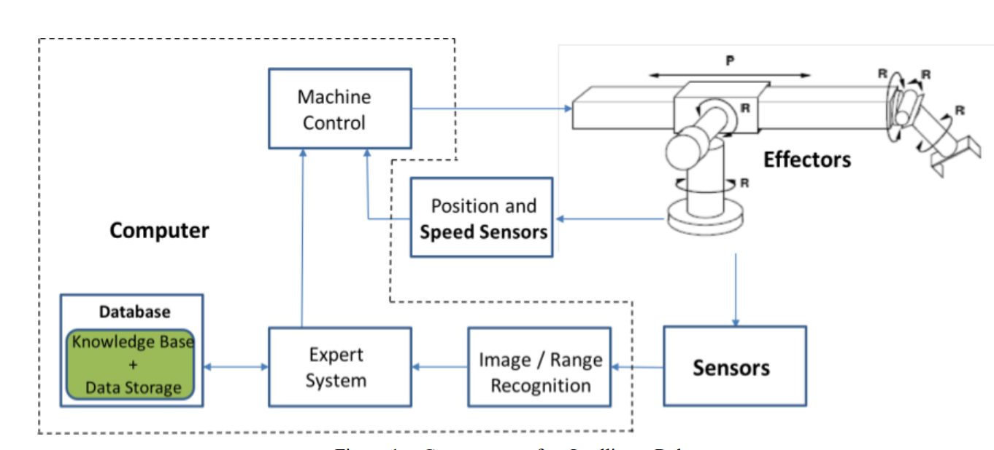
Components of an Intelligent Robot
z

Slide 13
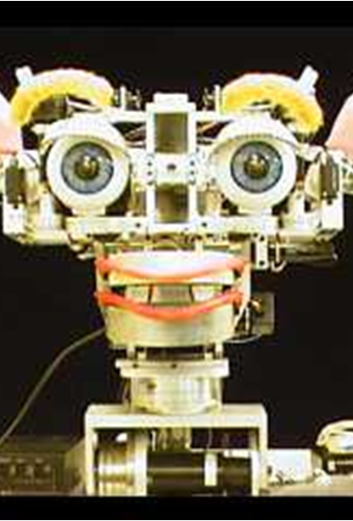
Kismet Smiling
Kismet is a robot head made in the late 1990s at Massachusetts Institute of Technology by Dr. Cynthia Breazeal as an experiment in affective computing,
The machine that can recognize proper emotional response to stimuli and exhibits corresponding facial expression, body posture, and vocal quality
Behavioral response serves either social or self-maintenance functions
To facilitate a natural infant-caretaker interaction, the robot is equipped with visual, auditory, and proprioceptive sensory inputs

Slide 14
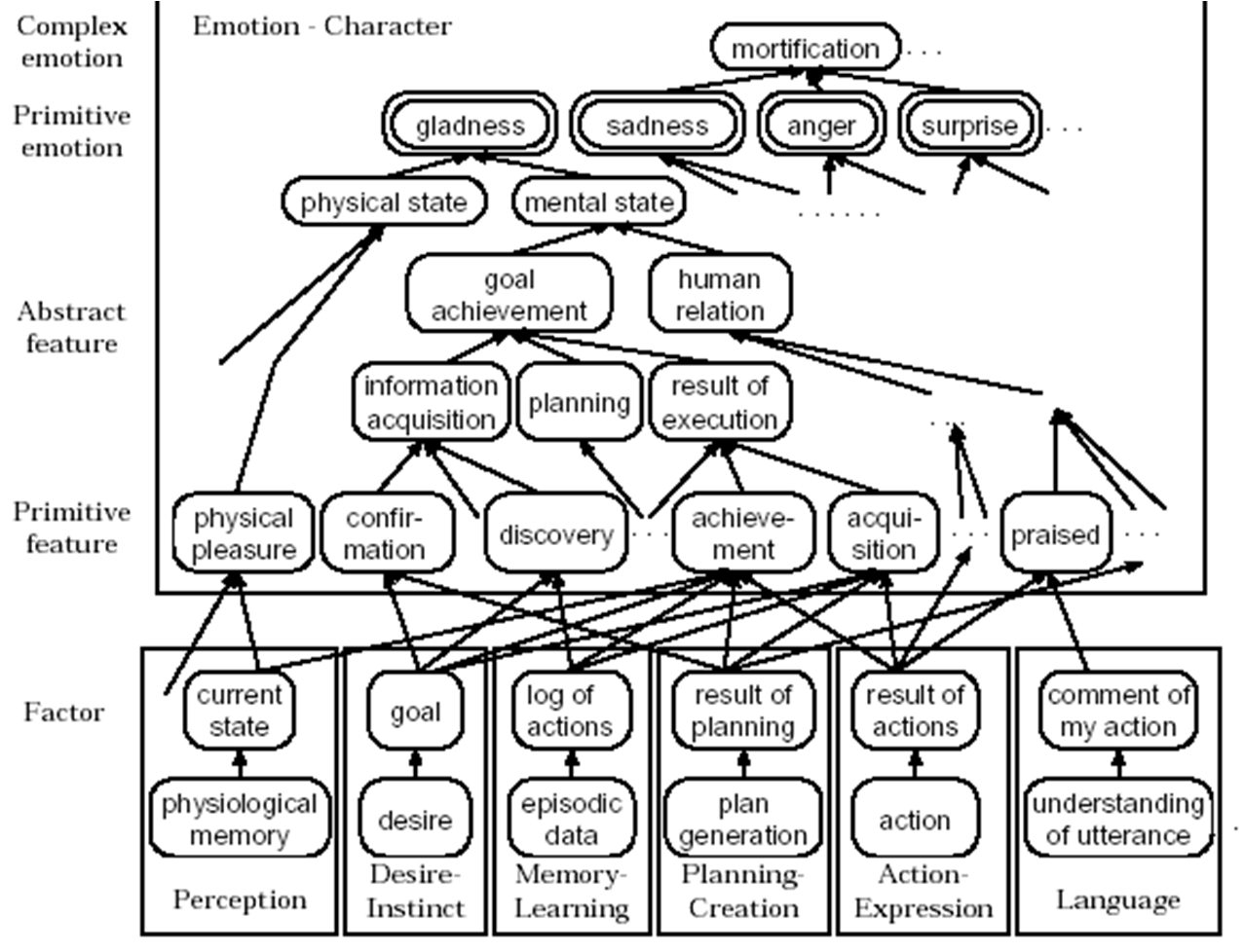
Complexity of Emotional Classification

Slide 15
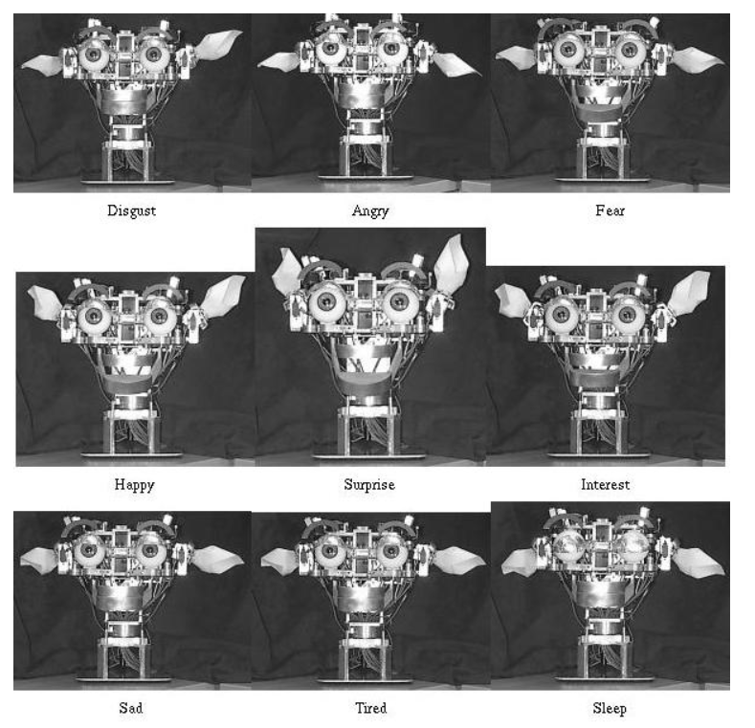

Slide 16
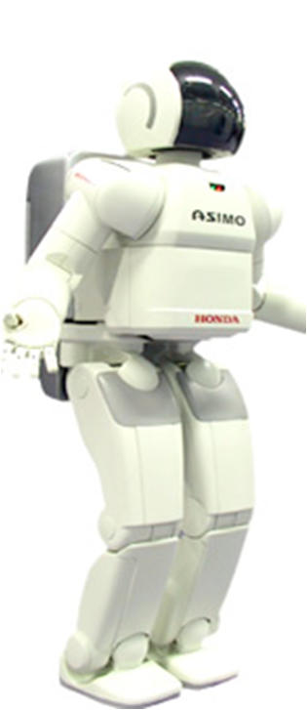
ASIMO
Also known as Honda’s Asimo (Advanced Step in Innovative Mobility)
It was created by Honda in 2000.
It is able to walk freely (can change stride speed)
It is able to balance on one foot
It is able to climb stairs
It is able to manipulate objects
It is Space- & cost-efficient

Slide 17
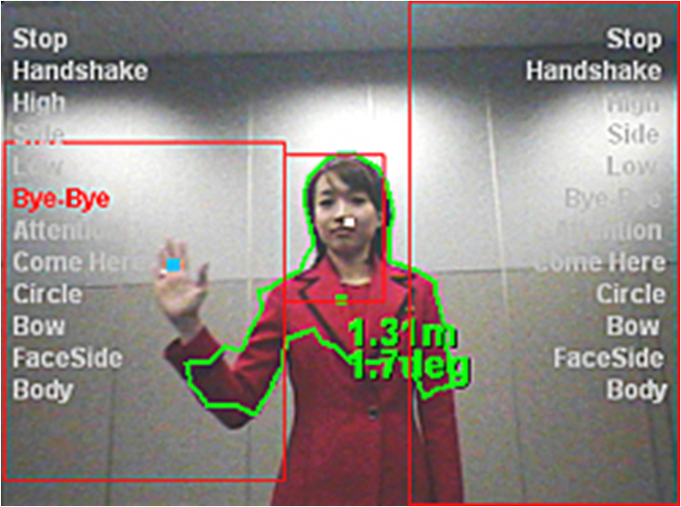
ASIMO’s Recognition Technology
Based on visual cues such as the angle and distance at which it perceives an object
It can map an object's contour and compare it to a database of prototypes for different expressions and actions

Slide 18
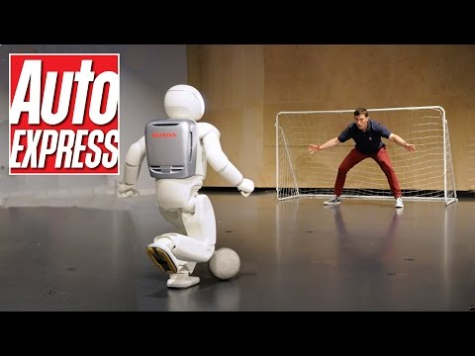
https://www.youtube.com/watch?v=QdQL11uWWcI

Slide 19

CONCLUSION
Using more techniques in AI and ML we can make robots more intelligent.
By improving robot we can make life easy and reduce stress on humans.
Its less time consuming.

Slide 20

Thank you
z

